Slide 1


NEXT GEN EMPLOYABILITY PROGRAM
CREATING A FUTURE-READY WORKFORCE

Slide 2
Student Name : AADHYA A
Student ID : STU645f6402278541683973122
College Name : Sri Venkateshwara College Of Engineering

Slide 3
CAPSTONE PROJECT SHOWCASE
EY GDS - AICTE Internship : Advanced Data Analytics
Project Title : Healthcare Prediction On Diabetic Patient Using Python
Abstract | Problem Statement | Project Overview | Proposed Solution | Technology Used | Modelling & Results | Conclusion

Slide 4
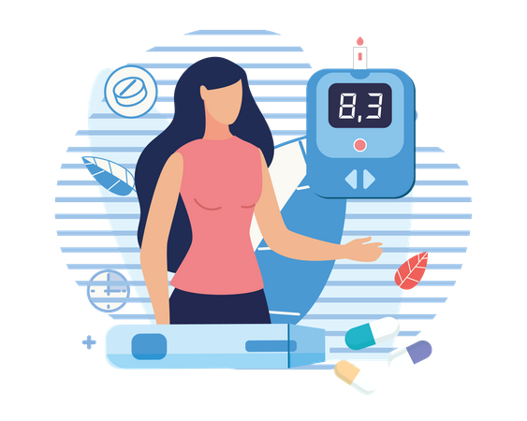
Abstract
This project focuses on leveraging Python for healthcare prediction in diabetic patients.
We aim to develop a predictive model to assist healthcare professionals in early diagnosis and proactive management of diabetes-related health issues.
By analyzing relevant data, our goal is to contribute to improved patient outcomes and resource optimization within healthcare systems.

Slide 5
Problem Statement
Diabetes is a global health concern, affecting millions of individuals.
The challenge lies in early identification of health risks associated with diabetes, allowing for timely intervention and personalized care.
Current healthcare systems face limitations in efficiently predicting and managing diabetic patient outcomes, necessitating the development of advanced predictive models.

Slide 6
Project Overview
Our project integrates machine learning techniques with healthcare data to create a predictive model for diabetic patient outcomes.
We leverage a comprehensive dataset, including patient demographics, medical history, and lifestyle factors.
The project encompasses data preprocessing, model training, and validation to provide a holistic view of diabetic patient health.

Slide 7
Proposed Solution
To address the healthcare prediction challenge, we employ machine learning algorithms such as logistic regression and decision trees.
Python serves as the primary programming language, facilitating seamless integration of data analysis, model development, and result visualization.
Our approach aims to provide accurate predictions and actionable insights for healthcare professionals.

Slide 8
Technology Used
Python: Primary programming language for data analysis, modeling, and visualization.
Scikit-learn: Utilized for implementing machine learning algorithms.
Pandas and NumPy: Employed for data manipulation and preprocessing.
Matplotlib and Seaborn: Used for visualizing data and model results.

Slide 9
Modelling & Results
We implemented various machine learning models, including logistic regression and decision trees, using a labeled dataset comprising diabetic patient records.
Performance metrics, such as accuracy, precision, and recall, were used to evaluate model effectiveness.
The results indicate promising predictive capabilities, demonstrating the potential of our approach in enhancing diabetic patient care.

Slide 10
Conclusion
In conclusion, our project demonstrates the feasibility and effectiveness of using Python-based machine learning models for healthcare prediction in diabetic patients.
The predictive capabilities achieved underscore the potential for enhancing early diagnosis and personalized care.
While our models show promise, ongoing research and collaboration with healthcare professionals are essential for further refinement and real-world implementation.

Slide 11
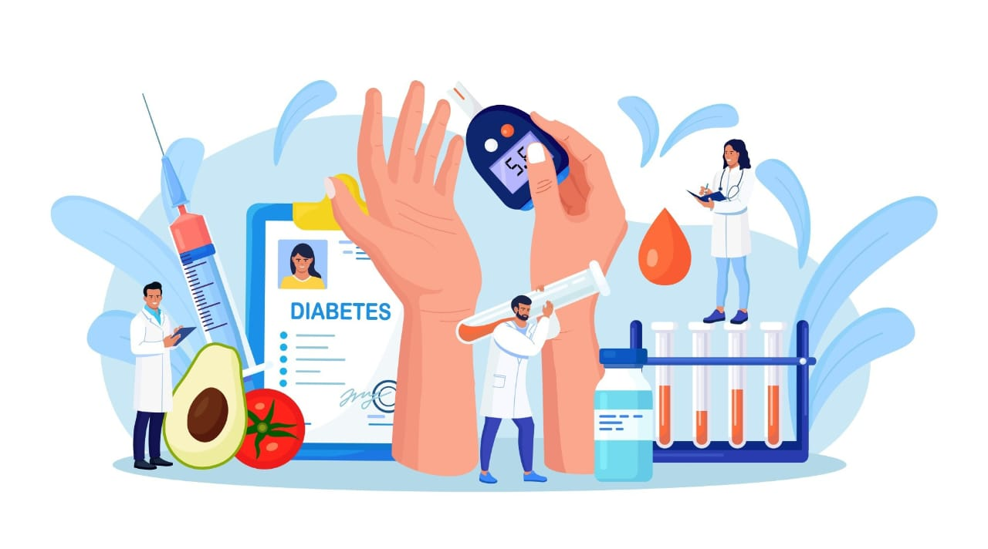
Thank You!
Notes:
Thank You !!

